Slide 1
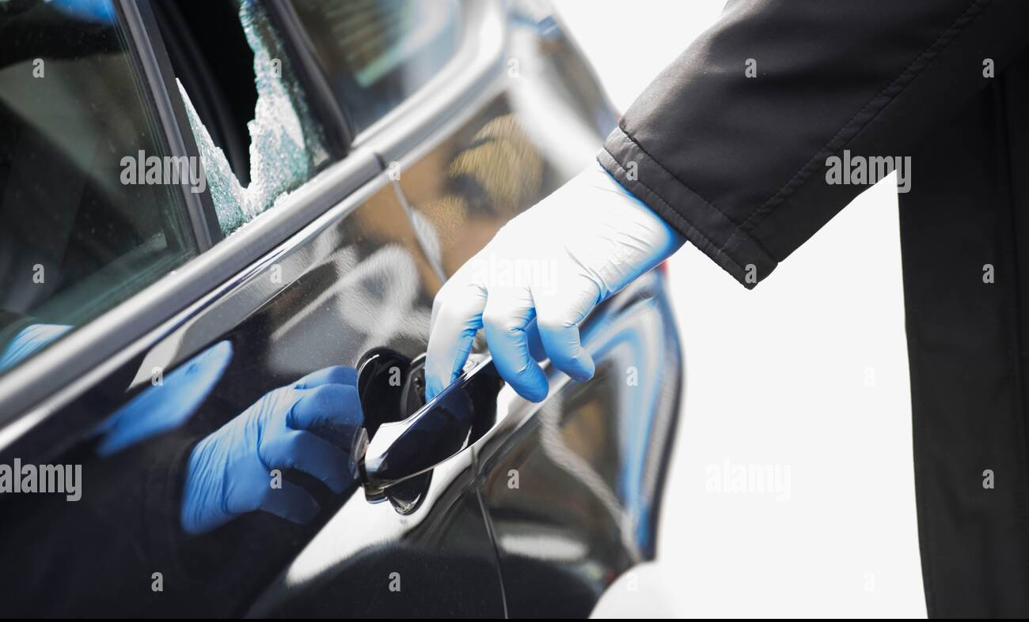
Vehicle Forensic
Created By:-Pratham Prajapati
Branch:-CS12
Roll No:-CS14
Subject:-ESFP
PID:-93

Slide 2
Challenges Faced By Department
As previously discussed, modern-day vehicles can be viewed as a typical computing system with different electronic modules connected and controlled by different computing devices in the vehicle.
The information is being sent over buses, which is an internal communication network that connects components inside the vehicle.
This allows the components and the vehicles to interact with each other. We also remark that
Just like any other digital investigations, forensic tools are needed to conduct an investigation. A natural question is whether existing commercial and open-source forensic tools are suitable for vehicle forensic investigations.
Existing commercial and open-source forensic solution market can be broadly categorized into general forensic suites and solutions (software and hardware) for a specific purpose

Slide 3
we examined a Volkswagen Golf version 6, 2012 station wagon. This car has several modules in which digital information can be found on the ECU (also known as Engine Control Module – ECM), TCU, ABS and BCM.
As mentioned above, vehicles today are more and more connected to the Internet.
Such connection over the Internet allows one the opportunity to intercept communication data. In our case study, we focused on GSM/3G/4G networks.
The aim of analyzing mobile traffic data is to examine the location and use of a vehicle. Normally, vehicle manufacturers would encrypt such communication data.
However, metadata is generally unencrypted. We will now discuss the interception of mobile data from a car

Slide 4
Solution For Challanges
About. Forensic science is a critical element of the criminal justice system.
Forensic scientists examine and analyze evidence from crime scenes and elsewhere to develop objective findings that can assist in the investigation and prosecution of perpetrators of crime or absolve an innocent person from suspicion.

Slide 5
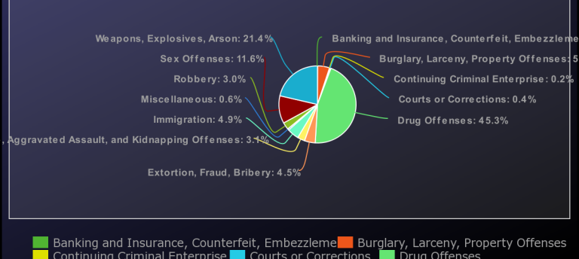
Vehicle Used For Crimes

Slide 6
Reference
https://www.salvationdata.com/knowledge/what-is-digital-vehicle-forensics/
https://www.sciencedirect.com/science/article/abs/pii/S0167739X17322422

